Slide 1
Burnley High School
School Performance update 2019/2020
Love, Grace and Fellowship

Slide 2
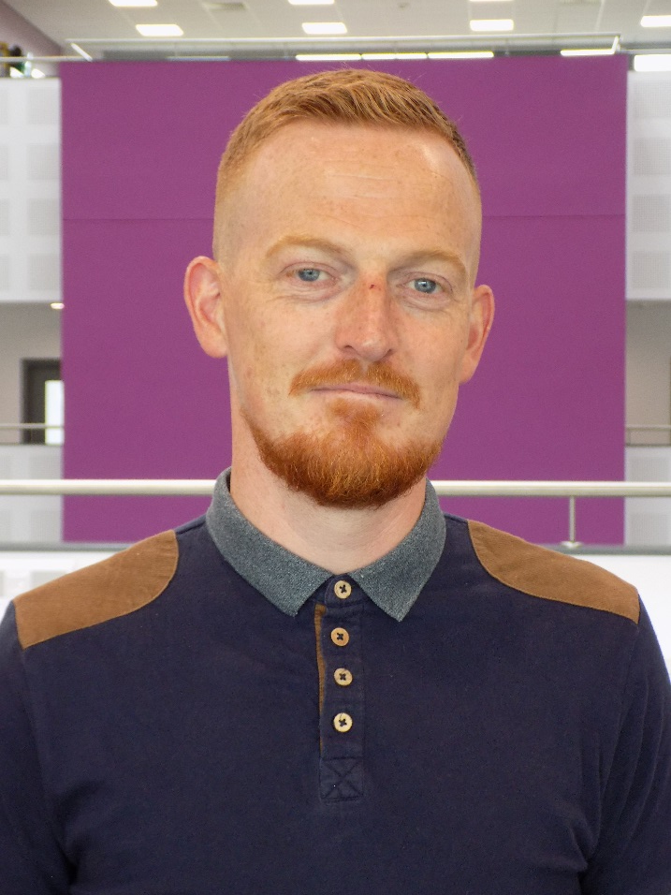
Headteacher
We are extremely proud of our first set of results here at Burnley High School and feel that they help validate the hard work, dedication and vision that we have had for the last 5 years. All of the key performance measures set out from the department for education show that we are a school that performs above the national average and more importantly for the community of Burnley and Padiham, the highest in Burnley. As the school grows, so will the entry level of EBacc with the intention to match the government target of 75% of pupils studying the EBacc subject combination at GCSE by 2022. We believe that these results, amongst other things, establishes Burnley High School as a viable and attractive option for families in the local area. If you have any questions than please get in touch.
Headteacher
Mr P Walmsley

Slide 3
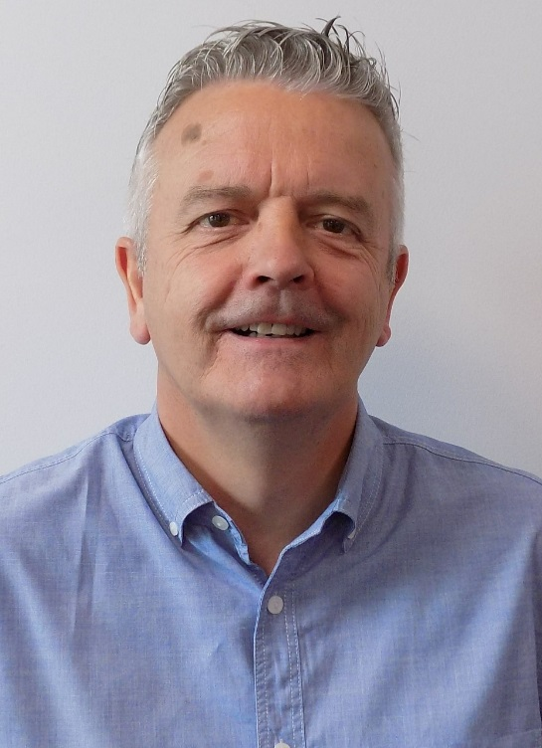
Governors
The Governors are delighted with this first set of results which we see as fulfilment of our dream to see this great school established in Burnley. We are delighted that our strong ethos and values, together with our commitment to educational achievement, can be clearly seen throughout our school.
This strong performance is testimony to the hard work of our pupils, the skill and dedication of our teaching staff and the support of the whole Burnley High School family.
We will continue to be committed to raising aspirations by believing in our students to exceed expectations and achieve great things.
Jeff Brunton
Chair of Governors

Slide 4
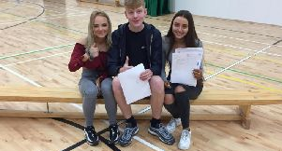
GCSE Success
Burnley High Schools first GCSE results were an amazing success with a progress 8 score of +0.03 and attainment 8 score of 47.9 placing the school as the best in Burnley
 | Burnley High School | Lancashire | National
Progress 8 | +0.03 | -0.11 | -0.02
Attainment 8 | 47.9 | 46.7 | 46.7

Slide 5
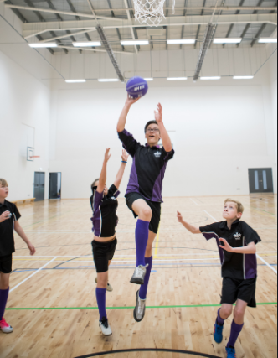
Grade 5 or above in English and Maths
We are particularly proud of our achievements in Maths and English with both subjects showing strong results way above national average.
 | Burnley High School | Lancashire | National
Grade 5 or more in English and Maths | 55% | 44% | 43%

Slide 6
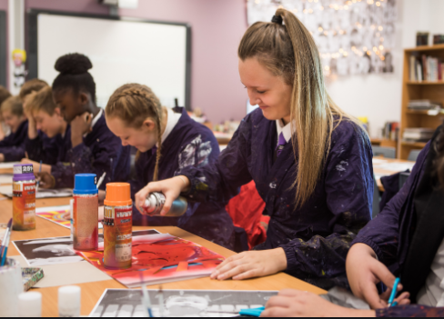
EBACC
Our EBACC average point score is again above national average showing our success in our EBACC subjects of English, Maths, Science, History, Geography and MFL
 | Burnley High School | Lancashire | National
EBACC Average point score | 4.17 | 4.02 | 4.07
Entering EBACC | 24% | 33% | 40%
As the school grows, so will the entry level of EBacc with the intention to match the government target of 75% of pupils studying the EBacc subject combination at GCSE by 2022, and 90% by 2025

Slide 7
Students staying in education or entering employment
These figures will be updated later in the year.

