Slide 1
You have 3 minutes to write what you think is important when choosing your career Timer Extension: Explain how this could effect you in years to come?
Connect – Connect your thinking to the content
Notes:
Answers could include progression routes from the basic job, how much you could earn from that job, is it a job you could do for the rest of your life?. Ensure the qualifications you decide to do match your career. Be ambitious but be realistic, is it a career you can achieve and excel in. EXTENSION: job satisfaction – you will either be happy with your career or unhappy if you have chosen the wrong one. You may decide to retrain if your qualifications are very specific to your career etc.

Slide 2
Demonstrate – This is where you apply and embed your knowledge
It is normal to not fully know what you want to do when you are between 14 and 16 years old, but it is important that you invest your time to find what might be right for you
SO………..Why is it important to choose the right career?
Making sure you enjoy what you do for most days of the week!
Ensuring the job you pick either pays enough to fund your lifestyle or the career has progression routes with pay rises attached
Ensuring you do the right qualifications for that job
To be ambitious, but realistic. There are lots of amazing jobs out there for everyone. Just because you are not predicted grade 8s DOES NOT MEAN YOU WILL NOT SUCCEED!!!.
How can this effect you in years to come?
Job satisfaction – Happy or unhappy
The need to retrain later on in life to change career
Financially – If the career you have chosen has no progression, the lack of income could impact your home life and even mental health
Notes:
Answers could include progression routes from the basic job, how much you could earn from that job, is it a job you could do for the rest of your life?. Ensure the qualifications you decide to do match your career. Be ambitious but be realistic, is it a career you can achieve and excel in. EXTENSION: job satisfaction – you will either be happy with your career or unhappy if you have chosen the wrong one. You may decide to retrain if your qualifications are very specific to your career etc.

Slide 3
Careers virtual tour
Creative Thinker
Effective Participator
Independent Enquirer
Reflective Learner
Self Manager
Team Worker
Todays Date
Is there anything I could add?
Have I answered in the expected level of detail?
Have I used vocabulary effectively?
Have I written in full sentences?
Have I checked SPaG?
Literacy

Slide 4
Objectives and Outcomes
Identify expectations of at least 2 different jobs
Expected
Explain at least 3 different skills required for a specific job
Challenge
Make a factsheet/poster on a specific career
Stretch
Careers Link
Gaining access to employment and understanding different career options

Slide 5
Activate – This is where you absorb information
Job Sectors:
In the working world there are many different sectors. Examples of this are:
The Military
Retail
Create a spider diagram on all the different sectors you can think of – then discuss with the class
Notes:
Next 2 slides have all sectors

Slide 6
Demonstrate – This is where you apply and embed your knowledge
Job Sectors:
Notes:
Explain each sector has lots and lots of different jobs. For example being in the military you can be a chef, many different types of engineers, mechanics, medics etc.

Slide 7
Demonstrate – This is where you apply and embed your knowledge
Job Sectors:

Slide 8
Activate – This is where you absorb information
Now we know the sectors we now need to know the different roles available and what skills are required in each role.
From the link below decide on different sectors and different roles that YOU are most interested as a class.
Use this as a chance to find out about as many careers and pathways as possible.
Make notes for each job role – the skills required, qualifications needed, wage (if stated), hours of work (if stated), what type of courses are required (BTECS, A levels, Apprenticeships, Degree etc), what progression can be made (if stated)
https://icould.com/explore/categories/job-types/cars-and-automotive/

Slide 9
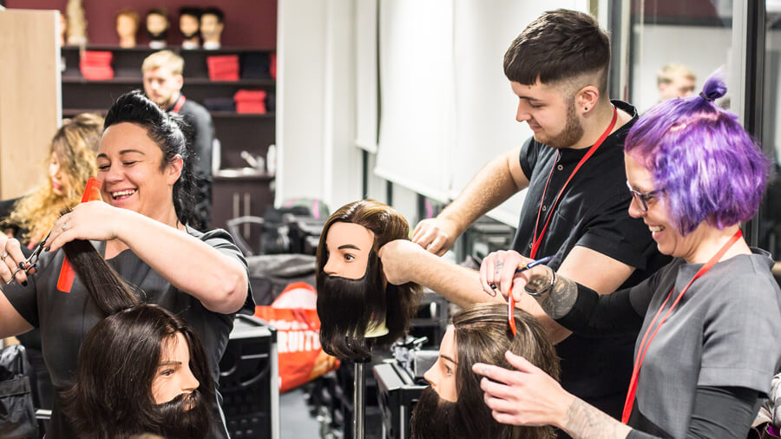
Activate – This is where you absorb information
Task time:
Pick 3 different jobs/careers from the video’s you have watched.
Make a list of all the skills required for that specific job
Make a list of all the different qualifications required for that specific job
What hours do you think could be involved with each specific job
What progression routes are there? (Teacher refer back to website if required)
Discuss with the teacher once completed, compare with each others careers

Slide 10
Activate – This is where you absorb information
Task Time:
Choose your intended career and design a fact sheet/poster about the skills required, wage, progression routes and any facts about the job.

Slide 11
Objectives and Outcomes
Identify expectations of at least 2 different jobs
Expected
Explain at least 3 different skills required for a specific job
Challenge
Make a factsheet/poster on a specific career
Stretch
Careers Link
Gaining access to employment and understanding different career options

Slide 12
KW
My Next Challenge
Key Word
Misconception
(Link to Rubric – Purple Pen)
SA
PA
Feedback
Self Assessment
(Link to Rubric – Purple Pen)
(Purple Pen Response)
Peer Assessment
(Link to Rubric – Green Pen)
Marking
(Green Pen)
Confidence Faces
(How do you feel you have achieved – Purple Pen)

Slide 13
WWW...
What went well
EBI...
Even better if
The way you have…
Is exactly what examiners are looking for. Though why not try …
You have not done… correctly, you need to…
To progress you need to…
You’ve achieved Grade… on…
To move on you...
Target (T)…
PA
I like the way you have…
Why not try…
Peer Assessment
(Link to Rubric – Green Pen)
Next time you must…
Strength
Strength
Way of improving
The most important thing to remember about these questions is to…
I think you are progressed on…
But not on…

Slide 14
I am really pleased with...
Because…..
Today I have learned that...
Today I have tried to...
To progress I need to...
Today, I have learnt that…
I have been able to…
But I got stuck on...
SA
Before this lesson I could...
Now I can also...
Self Assessment
(Link to Rubric – Purple Pen)
One thing I need to remember from today’s lesson is...
I was successful when I…
I can see the link between...
I did not know how to…
But now I can…

