Slide 1
1. The Trinity
Christians believe that there is only one God. The Nicene Creed explains that there is one being – God – experienced as three persons, Father, Son and Holy Spirit, who are all equal and all eternal.
‘We believe in one God, the Father, the Almighty…we believe in one Lord Jesus Christ, the only Son of God, eternally begotten of the Father, God from God…begotten not made, of one Being with the father…We believe in the Holy Spirit, the Lord, the giver of life, who proceeds from the Father and the Son’
Oneness of God
Believing in one God is called monotheism. Christians believe this because:
- Teachings in the Old and New Testament of one God
- First of the 10 commandments which are rules about belief and behaviour
- Teachings of the Church as seen in the Creeds
Christian attitudes
Many Christians find the Trinity a difficult concept but believe in the different aspects of one God. There are some Christian groups that do not accept the Trinity as stated in the creed. They are:
- Church of Latter Day Saints (Mormons) three separate beings united as one God
- Jehovah’s witnesses Only one true God, Jesus was created by God and so God’s son and Holy Spirit is Gods power.
- Unitarians Only one God, Jesus was a man and no difference between God and Holy Spirit.
How the Trinity is used in belief and worship
- The Nicene Creed is repeated during Eucharist weekly
- Catholics show their belief in the Trinity by crossing themselves when they enter a Church.
- Priests begin their sermons with ‘In the name of the Father, and of the Son and of the Holy Spirit’
- Baptisms and marriages are performed in the name of the Trinity
2. Creation
All Christians believe that God was responsible for the creation of the universe.
3. Incarnation
The incarnation is the Christian belief that God became a human being in Jesus. It is believed that due to Adam and Eve’s original sin in the Garden of Eden. God and humans could only have a partial relationship. Through the death and resurrection of Jesus, the power of sin was cancelled so it is possible for humans to have a relationship with God and enter heaven. Jesus had two natures, human natures and divine nature. The virgin birth is important as it shows Jesus as the Son of God, if Jesus had been conceived through sex and not the Holy Spirit then Jesus was not incarnate, just a man.
Biblical basis
Matthews Gospel – Talks of the virgin birth and the birth of Jesus
Luke’s Gospel – Talks of the visit from Angel Gabriel and the story of Shepherds informed of the birth of Jesus
John’s Gospel – identifies Jesus as the Word of God. He firstly refers to Jesus as the creator of everything and light and life of the world. John continues clearly references Jesus as God in human form: the incarnation:
‘The Word became flesh and made his dwelling among us. We have seen his glory, the glory of One and Only who came from the Father full of grace and truth’ (John 1:14)
The importance and significance of the incarnation
- It shows that God cared so much about the world that he send his Son to show humans what God is like and to teach how to live
- It is the basis of Christian faith
- In Jesus, Christians can see what God is like
- Through the incarnation, God began the process of salvation from sin
Genesis 1 | Genesis 2 & 3
Day 1 – Created heaven and earth, light and day Day 2 – separated the earth from the sky Day 3 – created dry land, plants and trees Day 4 – created sun, moon and stars Day 5 – created fish and birds Day 6 – created animals and humans | - God created the heavens and the earth - Formed man from dust and breathed life into him - Made trees and the Garden of Eden - Made a companion for Adam from his rib - Ate the forbidden fruit from the Garden and condemned to suffer.
Christians attitudes
Literalist – Bible is taken word for word
Conservatives – Writers of the Bible were inspired by God and guided by God
Liberals – Bible is a book of words about God but not words of God. The Bible provides a metaphor or symbolism for Christians.
Creation in the New Testament
John’s Gospel records creation in the New Testament:
‘In the beginning was the Word, and the Word was with God, and the Word was God’ (John 1:1)
Meaning everything was made through the Word and that without the Word ‘nothing was made’. John identifies the Word with Jesus, the Son, meaning creation was made by the Trinity.
Importance for Christians today
- Beliefs about Gods creation is that they show God’s goodness
- God created human beings in his image, meaning that humans occupy a unique place in creation
- Represents the huge responsibility given to humans to care for God’s creation (Stewardship)
God the Father helps Christians to understand His power and creativity. He cares and loves his creation.
Christian beliefs
5. The nature of salvation
Sin is an action that breaks God’s law. Sin makes it difficult to have a relationship with God. Sin can be original sin (inherited from Adam and Eve) or personal sin (consequence of a persons actions). Many Christians believe that those who die with unforgiven sin will not be able to enter heaven.
Salvation means being saved from sin. This is essential to have a relationship with God while on earth to achieve a place in heaven.
Role of Jesus in salvation
When Jesus died on the cross, his death paid for human sins and gave people the chance of salvation. When people believe in Jesus they believe that they receive God’s grace, which helps them to lead a good Christian life.
‘For God did not send his Son into the world to condemn the world, but to save the world through him’ (John 3:17)
Christians sometimes use the term atonement to describe the role of Jesus. Atonement means reconciliation between humans and God. Christians can receive the salvation offered by Jesus’ death by:
- Receiving the sacrament of baptism and confirmation
- Receiving the sacrament of the Eucharist
- Leading a Christian life
Why is salvation from sin important to Christians?
- Without salvation a persons sin can prevent them from a relationship with God and send them to hell or purgatory after death
- Salvation is the only way to eternal life
- Salvation from sin was the purpose of the life, death and resurrection of Jesus.
Different Christians understanding of atonement
4. The last days of Jesus’ life
Differences in the records of the Gospels
- Johns Gospel claims that Jesus’ body was anointed with spices before it was placed inside the tomb.
- Matthews gospel claims that there was a violent earthquake on the Sunday morning, an angel came and rolled the stone away from the tomb entrance.
- Matthew claims that the guards of the tomb were paid to say that they disciples had stolen the body
- Johns Gospel claims that Mary Magdalene found the tomb empty. She then met Jesus and mistook him for a gardener.
The importance of these events in understanding the purpose of the life of Jesus Christ
- The Last Supper is the basis of the Eucharist, the most important form of Christian worship
- Christians believe that Jesus’ death brought about salvation from sin
- The resurrection is the basis of the Christian belief in life after death and the promise that death is not the end.
- The ascension reminds Christians that Jesus has gone to heaven to prepare a place for them so they don’t fear death.
God the Holy Spirit helps Christians to understand the presence of God in the world.
God the Son helps Christians to understand the love of God, through Jesus’ life and death.
The Last Supper | The night before his crucifixion (Maundy Thursday) Jesus shared a meal with his disciples. Jesus broke bread and drank wine and gave instruction to do this in remembrance of him. ‘Then he too the cup, gave thanks and offered it to them, saying, ‘Drink from it, all of you. This is the new covenant in my blood which is poured out for you.’ (Luke 22:20)
The betrayal and arrest | Judas handed Jesus over to the Roman army for silver. There was a fight between the disciples and the chief priests who came to arrest him. Jesus ordered there to be no violence and was arrested.
The trial | Jesus was taken to trial who condemned him for claiming to be ‘the Christ, the son of God’, which they regarded as blasphemy. Pontius Pilate offered the release of a prisoner, the crowd chose another so Jesus was condemned to crucifixion, the soldiers laid a crown of thorns on his head and mocked him. The disciples ran away, only the women followers stayed by Jesus.
The crucifixion | Jesus and Simon of Cyrene carried the cross and Jesus was crucified on it on Friday. Jesus was taunted by the bystanders. The crucifixion lasted over 3 hours before Jesus died in agony.
The resurrection | Early on the Sunday morning, women went to anoint the body with spices. When they entered the tomb it was empty. The women were then visited by two men who told them that Jesus had risen which they passed onto the disciples. Jesus then appeared to the disciples.
The ascension | St Luke records that 40 days after the resurrection , Jesus told the remaining disciples to stay and receive the Holy Spirit then he was taken up from them into a cloud and two men in white appeared to tell them that Jesus had been taken into heaven (Acts 1:4-11)
Roman Catholic view | Evangelical Protestant view | Liberal Protestant view
Jesus sacrificed his life in an act of love to show his fathers love for humanity. Salvation comes from receiving the sacraments. | ‘Penal substitution theory’ – God’s justice meant that he needed to punish human sin but Jesus acted as a substitute for us. Salvation comes through faith in Jesus as the saviour | Jesus bought about atonement by acting as a moral example for humanity, through his teaching and life. Salvation comes through living the Christian life and following the teachings/example of Jesus
6. Christian eschatology
Immortality of the soul
Many Christians believe that people are made of body and soul. They believe that the soul is non-material and immortal. They believe that when the body dies, the soul leaves the body to live with God. They believe in this because after the ascension, Jesus became a spirit and went to the spirit world.
Heaven and hell
All Christians believe in heaven as a perfect place in the company of God. There are different attitudes about heaven and hell amongst Christians:
- Most Christians believe that all Christians will eventually go to heaven and that good followers of any religion may go to heaven
- Some Christians believe that only good Christians will go to heaven but bad Christians and everyone else will go to hell
- Some believe that all good people go to heaven whatever they believe
- Other Christians believe that there is no hell, only levels of heaven
Resurrection of the body
Some Christians believe that when people die their soul remains in the grave until the time when God will end the world. This is known as the Last Day , which will follow the Second Coming of Jesus. At this time, the dead will be raised and both the living and the dead will be given resurrection bodies. Everyone will appear in front of God for the final judgment. Some believe that those who have repented their sins will go to heaven. All others will go to hell as they have rejected God’s love. Many believe this because of Jesus’ body which physically rose from the dead.
Purgatory
Catholic Christians believe that purgatory is the place where those Christians who have died with unforgiven sins go to be purified of their sins so that they can go to heaven.
What does the Bible say about life after death?
A major Bible teaching on life after death comes from St Paul in 2 Corinthians 5:1-10, where he says:
- Christians know that if their body is destroyed they will have a non-physical home in heaven
- Christians long to be in heaven which is their goal
- Christians do all they can to please God on earth
- They do this as they know that everyone will appear before God to be judged on the good or bad they have done.
Why are these teachings important to Christians today
- Christians will try to live a good life (Parable of the sheep and the goats)
- Christians will seek salvation/atonement and avoid committing sin
- Give Christians’ lives meaning and purpose. They will be rewarded for their good deeds which makes it all worthwhile.

Slide 2
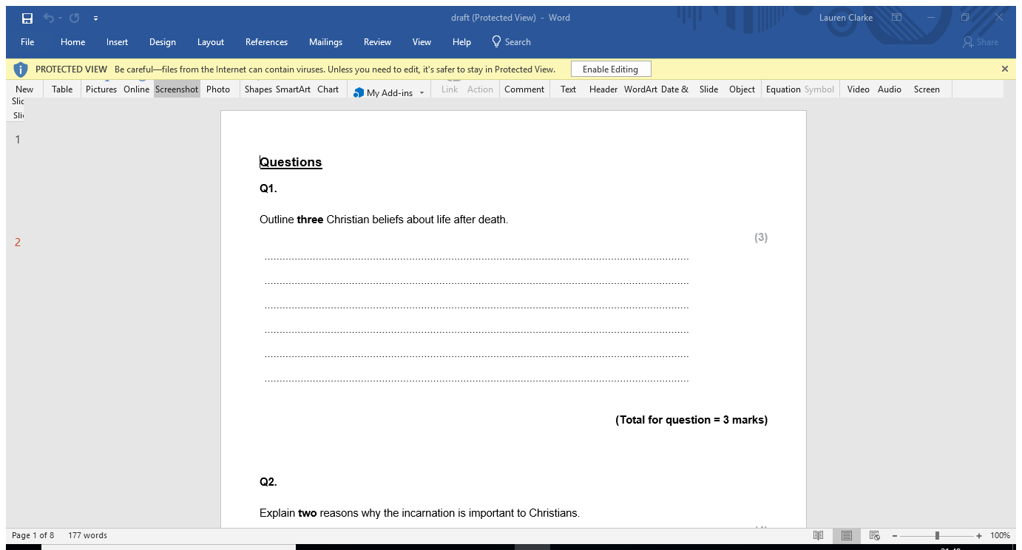





6. Evil and Suffering
Natural evil | Moral evil
Suffering not caused by humans. E.g. earthquakes, floods, volcanoes, tsunamis | Suffering caused by humans. E.g. rape, burglary, murder, war
Why evil raising questions about God
- If God is omnipotent(all-powerful) he must be able to remove suffering from the world
- If God is omnibenevolent (all-good), he must want to remove evil and suffering from the world as they cause such unhappiness
- If God was omniscient (all-knowing), he must have known there would be evil and suffering when he created the world
- If there is evil then God cannot exist or it is not the God we thought it was
Responses to evil and suffering.
Biblical responses | - There is no point in worrying about evil and suffering because we will never understand Gods reasons for it - Job remained faithful to God even though he was tested by the devil and rewarded by God for his steadfast faith. -Psalms teach that suffering is intended to be part of life and show many examples of good religious people who have suffered.
Theoretical responses | - God created humans with free will and humans have made the choices for themselves - Life is a preparation for paradise, to improve their souls they need to face suffering (Vale of soul making) - Good can come out of evil
Practical responses | - Jesus showed a practical response to suffering as he healed the sick, fed the hungry, challenged those who were evil and even raised the dead. - Pray for those who suffer - Offer practical help for those who suffer e.g. become doctors, nurses, social workers, charity workers etc. - Christian churches organise food banks, campaigns and charity groups.
Topics | I’ve got it! | Bits and bobs! | Oh dear!
The trinity
The creation of the universe and of humanity
The incarnation
The last days of Jesus’ life
The nature and significance of salvation and the role of Christ within salvation
Christian eschatology
The problem of evil/suffering and a loving and righteous God
Divergent solutions offered to the problem of evil/suffering and a loving and righteous God
Part d exam questions:
"Jesus had to die."
Evaluate this statement considering arguments for and against. In your response you should:
refer to Christian teachings
reach a justified conclusion.
‘ ‘Evil is not a problem for religious believers’ Evaluate this statement considering arguments for and against. In your response you should:
-refer to Christian teachings
-refer to different Christian points of view
-reach a justified conclusion

