Slide 1
You have 2 minutes to write what you think “Interview skills” means
Timer Extension: Explain how you think having poor interview skills can effect you getting a job?
Connect – Connect your thinking to the content
Notes:
Ask the question get the learners to write down either on paper or on a post it note and stick to the wall then discuss

Slide 2
Demonstrate – This is where you apply and embed your knowledge
SO………..what are interview skills?
Interview skills are the skills you need to display when attending an interview. You may have the highest qualifications possible but if you cannot perform well at interview others may be ahead of you
Interview Skills watch the video:
https://www.youtube.com/watch?v=HG68Ymazo18
Notes:
Read through the slide discussing images with text etc.

Slide 3
Interview Skills
Creative Thinker
Effective Participator
Independent Enquirer
Reflective Learner
Self Manager
Team Worker
Todays Date
Is there anything I could add?
Have I answered in the expected level of detail?
Have I used vocabulary effectively?
Have I written in full sentences?
Have I checked SPaG?
Literacy

Slide 4
Objectives and Outcomes
List at least 5 interview skills
Expected
Explain why interview skills are important
Challenge
Be able to relate skills to past experiences
Stretch
Careers Link
All Careers within the Burnley and Pendle area

Slide 5
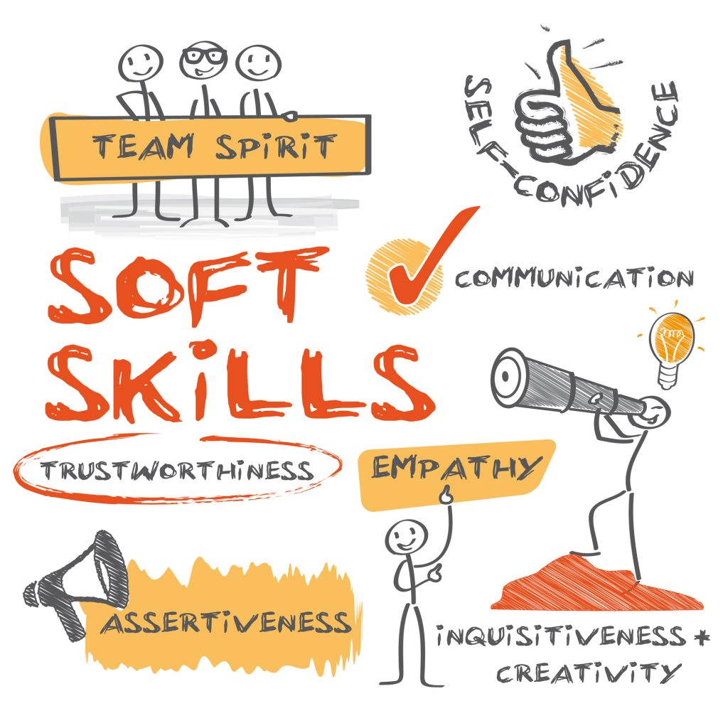
Demonstrate – This is where you apply and embed your knowledge
What are interview skills?
https://www.youtube.com/watch?v=7KYYmHr7tcE
Watch the video and make a spider diagram of all the interview skills are required – Try to think of others not mentioned in the video

Slide 6
Interview Skills:
Key interview skills :
Communication
Teamwork
Negotiation and persuasion
Problem solving
Leadership
Organisation
Perseverance
motivation.

Slide 7
Demonstrate – This is where you apply and embed your knowledge
Watch the following video’s
https://www.youtube.com/watch?v=EAqAgM_tfmU
https://www.youtube.com/watch?v=akjwDe081lA
https://www.youtube.com/watch?v=SieNfciN274
Watch each video, which are good interviews and why?
Highlight the poor interview/s and why you think they were poor?

Slide 8
Activate – This is where you absorb information
Making a good impression:
Task:
Create a Spider diagram:
Draw a line down part of your page, write “Good impression” on one side and “bad impression” on the other side.
Spend 5 minutes writing all the things you could do to make a good impression and write things that would make a bad impression
e.g. Good impression – Dressing professionally and smart.
Bad Impression – Turning up in your PJ’s

Slide 9
Activate – This is where you absorb information
Good impression:
Turning up early
Dressing to impress/professional
Researching about the company
Researching and practicing interview questions
Positive body language
Give examples in interview of past events you have done to show you not only understand the question, but you have experience with dealing with it too.
Bad impression:
Turning up late
Wearing PJ’s or inappropriate clothing
Negative body language
Not telling the truth at interview
Turning up unprepared
Not knowing the company you have applied to work for
Turning up smelling of substances you shouldn’t
Not researching interview questions
Not providing qualifications if you needed proof
Poor language in interview
Being on phone

Slide 10
Demonstrate – This is where you apply and embed your knowledge
TASK:
Spend 5 minutes with your shoulder buddy writing 3 good interview questions and prepare answers for them
Use examples from the video’s you have watched today.

Slide 11
Activate – This is where you absorb information
Interview question examples:
Tell Me About Yourself.
How Did You Hear About This Position?
Why Do You Want to Work at This Company?
Why Do You Want This Job?
Why Should We Hire You?
What Are Your Greatest Strengths?
What Do You Consider to Be Your Weaknesses?
With your teacher discuss what might be some good answers

Slide 12
Objectives and Outcomes
List at least 5 interview skills
Expected
Explain why interview skills are important
Challenge
Be able to relate skills to past experiences
Stretch
Careers Link
All Careers within the Burnley and Pendle area

Slide 13
KW
My Next Challenge
Key Word
Misconception
(Link to Rubric – Purple Pen)
SA
PA
Feedback
Self Assessment
(Link to Rubric – Purple Pen)
(Purple Pen Response)
Peer Assessment
(Link to Rubric – Green Pen)
Marking
(Green Pen)
Confidence Faces
(How do you feel you have achieved – Purple Pen)

Slide 14
WWW...
What went well
EBI...
Even better if
The way you have…
Is exactly what examiners are looking for. Though why not try …
You have not done… correctly, you need to…
To progress you need to…
You’ve achieved Grade… on…
To move on you...
Target (T)…
PA
I like the way you have…
Why not try…
Peer Assessment
(Link to Rubric – Green Pen)
Next time you must…
Strength
Strength
Way of improving
The most important thing to remember about these questions is to…
I think you are progressed on…
But not on…

Slide 15
I am really pleased with...
Because…..
Today I have learned that...
Today I have tried to...
To progress I need to...
Today, I have learnt that…
I have been able to…
But I got stuck on...
SA
Before this lesson I could...
Now I can also...
Self Assessment
(Link to Rubric – Purple Pen)
One thing I need to remember from today’s lesson is...
I was successful when I…
I can see the link between...
I did not know how to…
But now I can…

