Slide 1


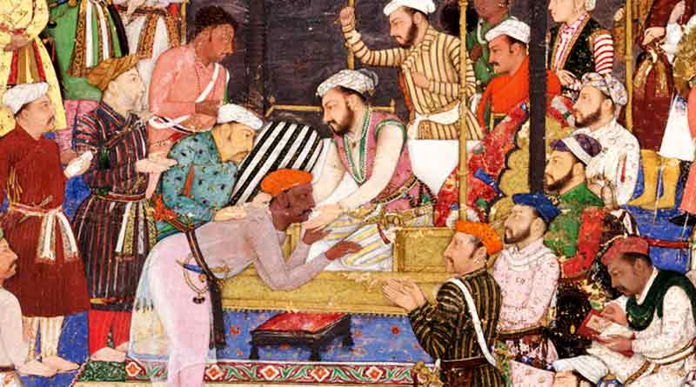



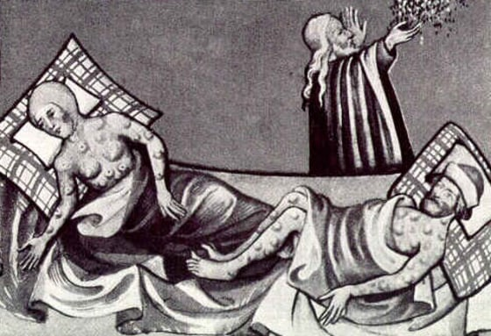
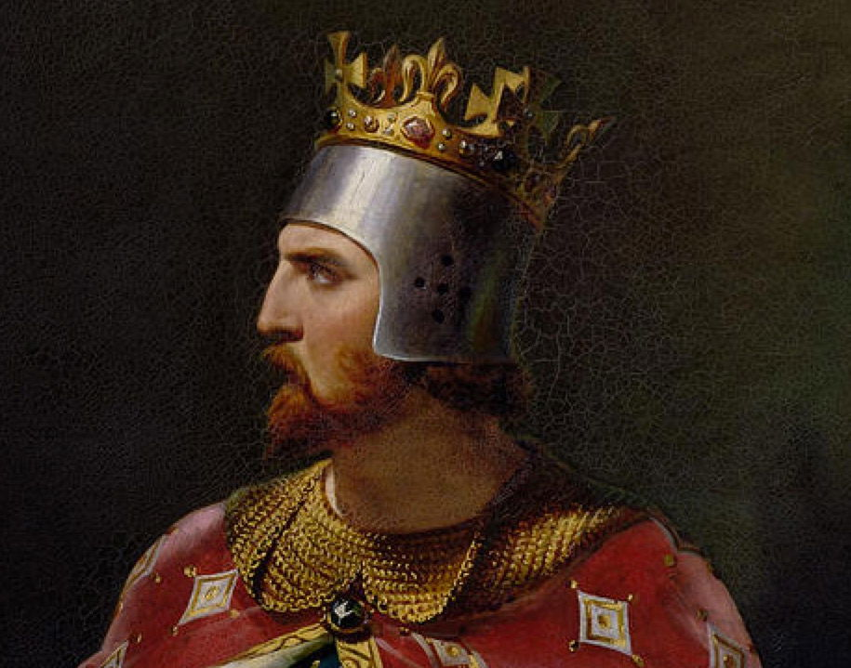
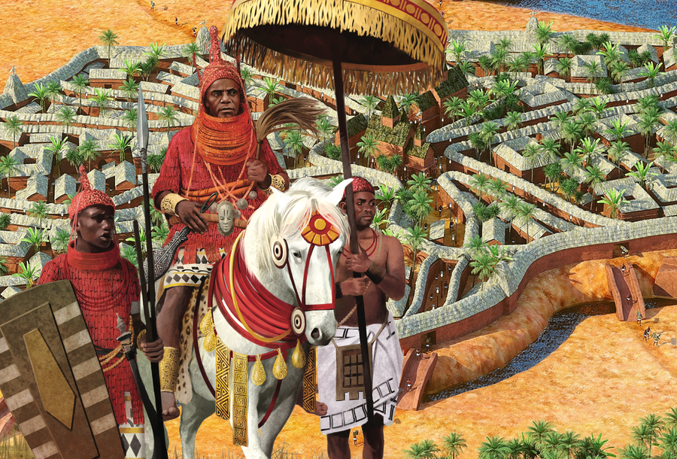
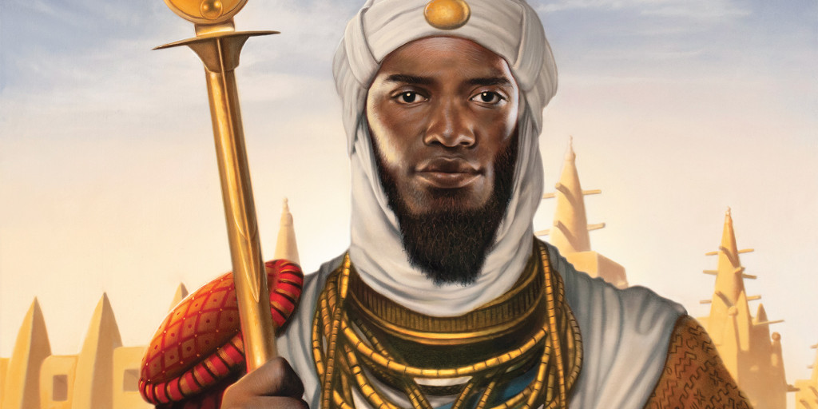
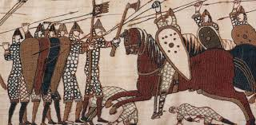
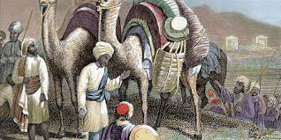

The BHS Learning Journey – Y7 History – c.500-1500
Year 8 this way!
Progress Check: How much power did women have in the Mughal Empire?
How id the Taj Mahal a symbol of Mughal Power?
What can we learn about the Mughal's from sources and paintings?
Summative Assessment: What mattered to the Mughals?
What was so 'great' about Akbar the Great?
How did the Mughal Empire begin?
Summative Assessment: How did the Black Death change Walsham?
What were the consequences of the Black Death for the villagers of Walsham?
How did the Black Death impact th4e villagers of Walsham?
Progress Check: What happened in Walsham as the Plague approached?
Year 7 Summer 3B
What mattered to the Mughals?
Year 7 Summer 3A
Where is Walsham and what was it like in the early 1340s?
What was life like in the Medieval village of Walsham?
Why was the Church so important to the village of Walsham?
Summative Assessment: How powerful were Medieval Monarchs?
How did the Black Death change Walsham?
How did Edward I increase his control over Wales?
Did Magna Carta benefit everyone??
Why is King John remembered as one of the worst Kings in History?
Progress Check: Why was Thomas Becket murdered in Canterbury Cathedral?
Why did Thomas Becket and Henry II fall out?
Who was Matilda and why was she important?
What role did Richard the Lionheart have in the Crusades?
How unlimited was the power of Medieval Plantagenet monarchs?
Year 7 Spring Term 2B
What does the life of Mansa Musa tell us about the Kingdom of Mali?
Progress Check: Why was Musa the greatest Mansa of Mali?​
How and why did the Kingdom of Benin rise and fall?
How do Historians know about the Kingdom of Benin?
What was so mighty about Benin city?
How and why did the Kingdom of Mali rise and fall?
Why was Benin known as the 'mighty' kingdom?
Summative Assessment: Why was Benin known as the 'mighty' Kingdom?
How do Historians know about the Kingdom of Mali?
Progress Check: Why was Norman Sicily known as 'one island' with many worlds?
How did Sicily connect worlds?
Why did the Normans invade Sicily?
Summative Assessment: Did the Normans bring a ‘truckload of trouble?
Year 7 Spring Term 2A
Why was Musa the greatest Mansa of Mali?
Why was Norman Sicily known as 'one island' with many worlds?
Why did the Normans order for the Harrying of the north?
Who should be crowned the next King of England?
What happened at Stamford Bridge?
What happened in the morning at Hastings?
What happened in the afternoon at Hastings?
Why did William win the Battle of Hastings?
Year 7 Autumn Term 1B
Why did the Normans make the Doomsday Book?
Did the Normans bring a ‘truckload of trouble?
Summative Assessment: What evidence do you have to support Peter Frankopan's view of the Silk Roads?
Why did the Normans build Motte and Bailey Castles?
Progress Check: Why was Baghdad the centre of the Silk Roads?
How was Baghdad central to the Silk Roads?
How did religion spread along the Silk Roads?
What was traded along the Silk Roads?
Why did the Normans establish the Feudal system?
Why were the Silk Roads so important?
Year 7 Autumn Term 1A
How did the Silk Roads impact Ancient China?
What were the Ancient Cities of the Silk Roads?
How did the Silk Roads lead to the spread of medicine?
How were the Silk Roads created?
Why were the Silk Roads important?

