Slide 1
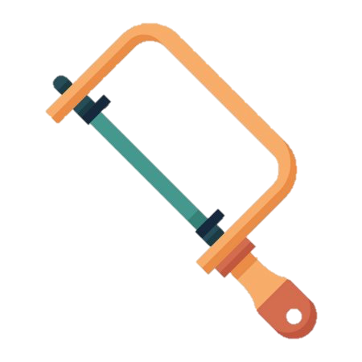



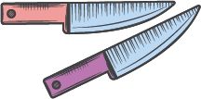



Year 7
Learning Journey
Year 8
Practical skills
End of unit assessment
Assessed work
PRODUCT DESIGN
AQUARIUM PROJECT
CAD/CAM
Specification
Diary of making
Tenon saw
Coping saw
Junior hacksaw
CAD/CAM
End of unit assessment
7e
D&T Element: Specification
Theory: CAD/CAM
Success criteria
Acronyms
Examples
Advantages/disadvantages
FOOD TECHNOLOGY
Assessed work
Practical skills
D&T Element: Plan of making
Nutrition
Plan of making
Food technology argument
Curry
Flatbread
Fajitas
Pasta bake
Carrot cakes
Ingredients
Equipment
Health and safety
Motivation wheelchair
Smart materials
Iterative design
End of unit assessment
7d
Theory: Nutrition
Assessed work
Eatwell Guide
Energy
Theory: Smart materials
Theory: Existing designer profile
Practical skills
D&T Element: Iterative designs
ETHOS PROJECT
INCLUSIVE DESIGN
Phosphorescent
Smart putty
Thermochromic
Colour pigments
Hydrochromic
David Constantine
Motivation wheelchair
TinkerCAD
Multiple sketches
User centered
Research
D&T Element: Evaluation
Assessed work
End of unit assessment
7c
Sensory words
Star diagram
Health and safety
Cross contamination
Evaluation
Practical skills
Theory: Cross contamination
Theory: Health and safety
FOOD TECHNOLOGY
Knife skills
Apple crumble
Flapjacks
Chicken goujons
Gingerbread biscuits
Bacteria
Prevention
Core temperature
Procedures
Good practice
Bridge and claw method
7b
Assessed work
End of unit assessment
Theory: Production methods
Design ideas
Hand stitching
Production methods
TEXTILES
DAY OF THE DEAD KEYRING
Practical skills
D&T Element: Design ideas
7a
Mass production
Batch production
One off production
Working conditions
Running stitch
Back stitch
Blanket stitch
Cross stitch
Annotation
Gradient shading
Slash rendering

