Slide 1

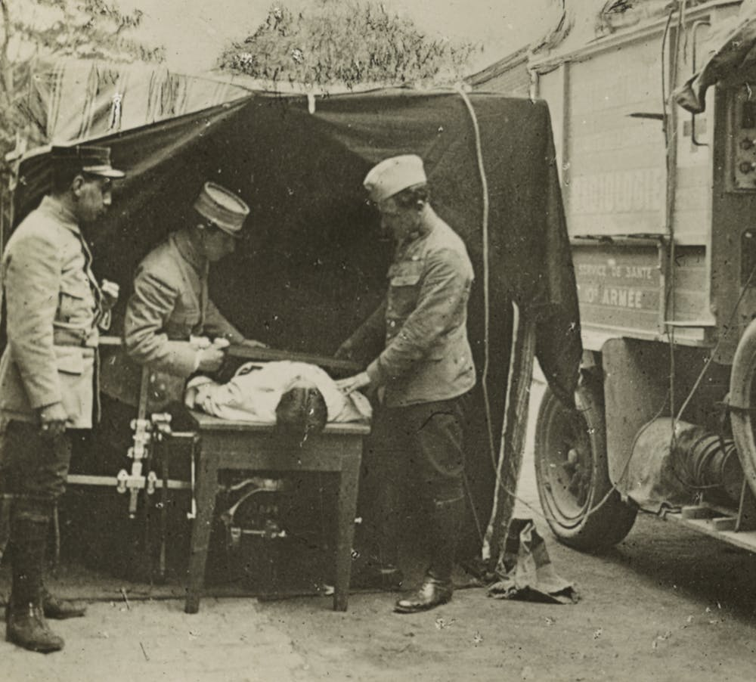



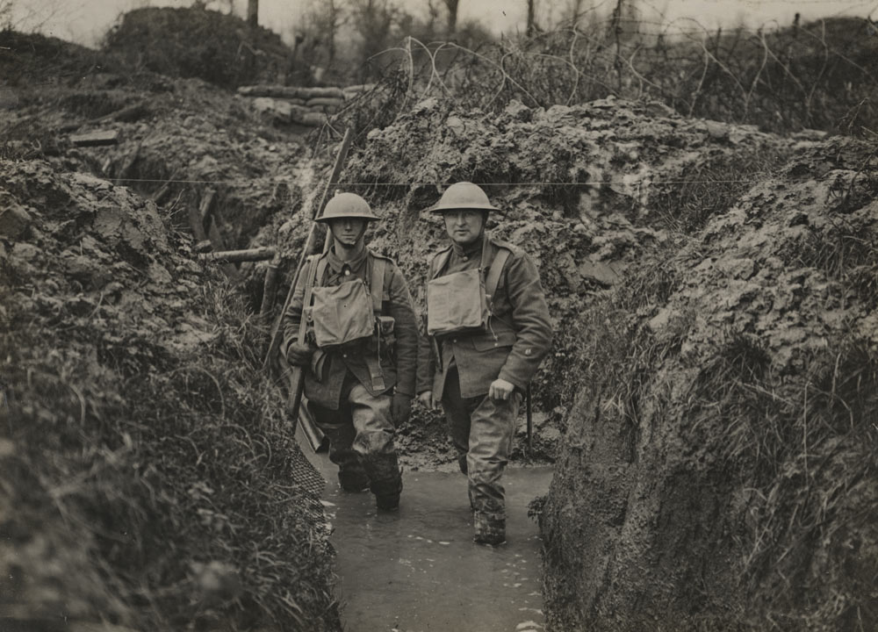

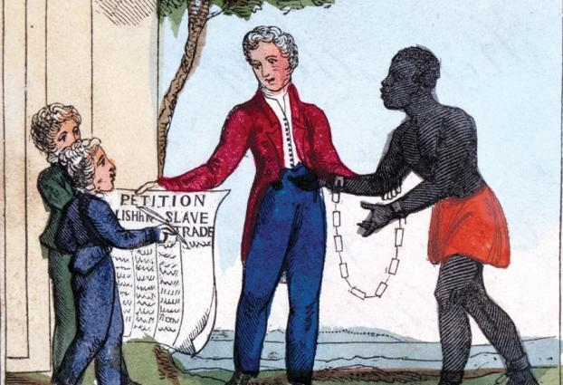
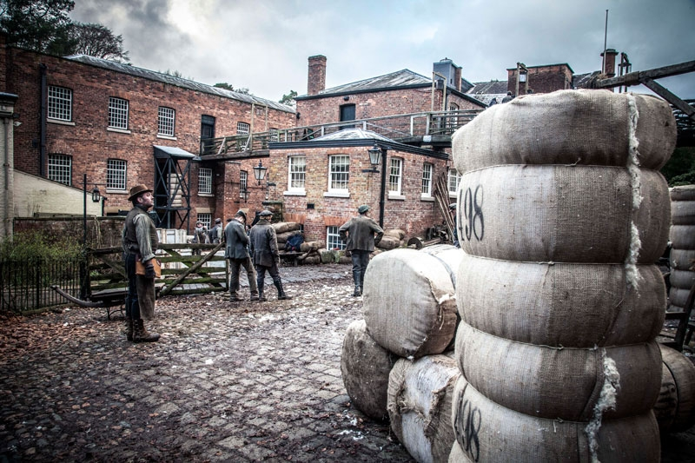
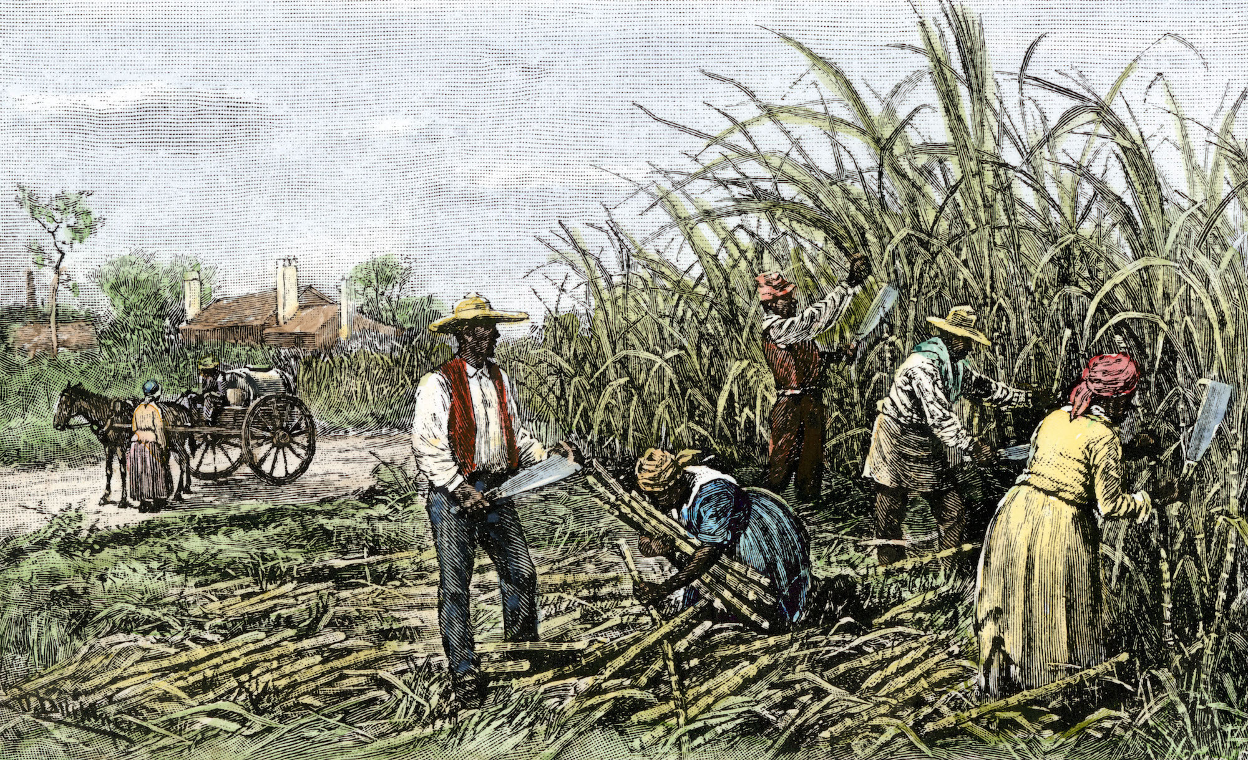
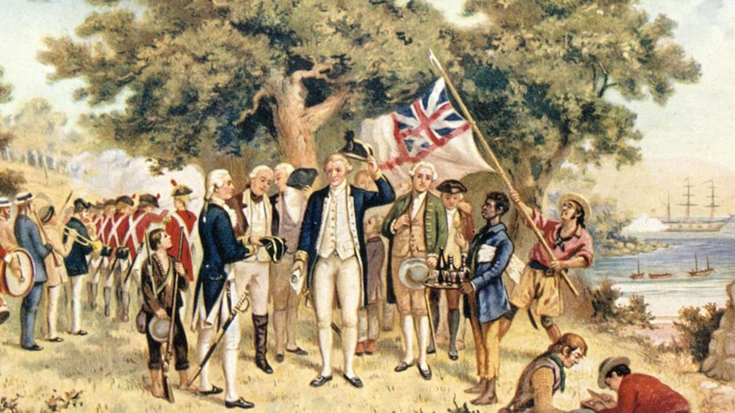
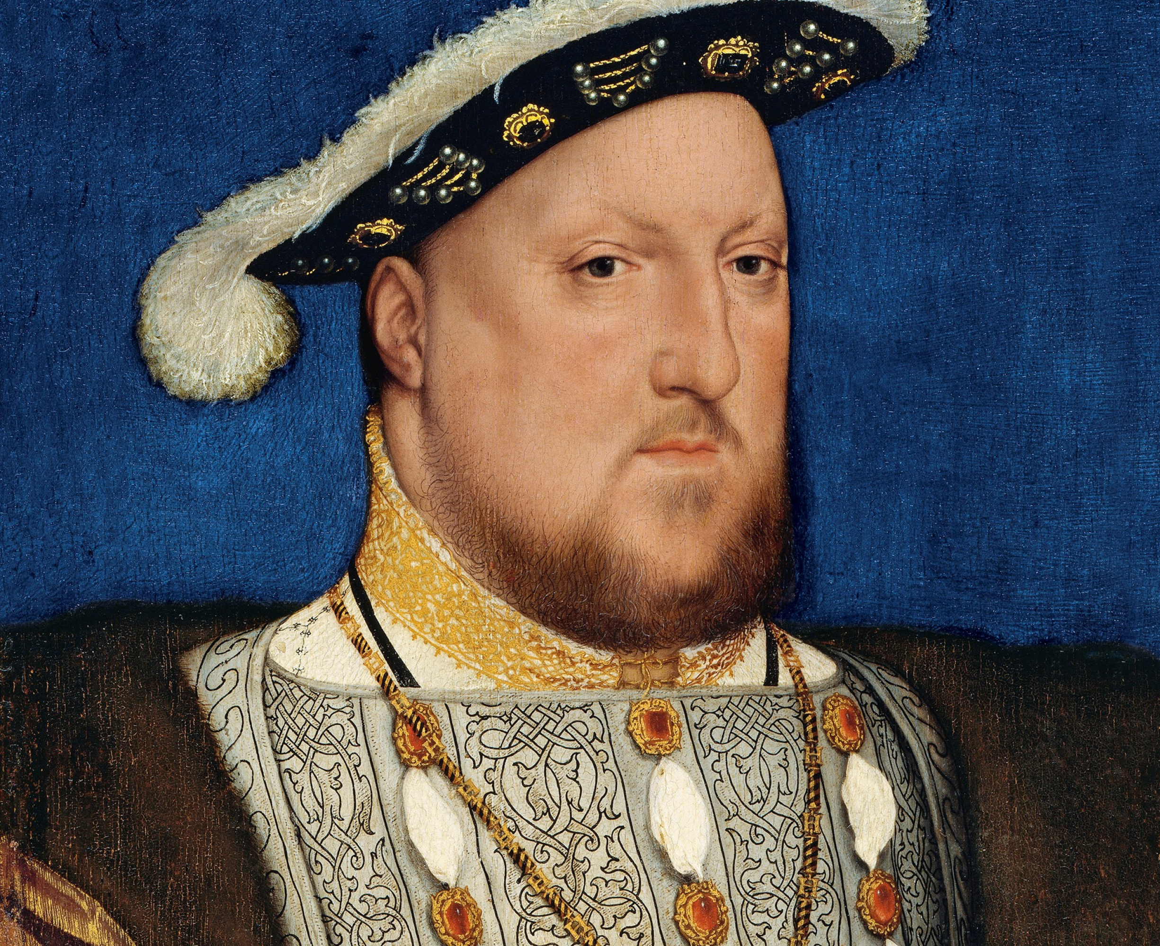
The BHS Learning Journey – Y8 History – c.1500-1918
Year 9 this way!
How were injured soldiers evacuated from the Western Front?
How were soldiers treated in a Regimental Aid Post?
What were Vera Britain's experiences of nursing on the Western Front?
Progress Check: How were soldiers treated on the Western Front?
End of Year 8 Preparation
What is shell shock and how did it impact soldiers on the Western Front?
What is trench fever and how was it caught?
Summative Assessment: What was it like for soldiers fighting in World War One?
Who was Walter Tull and why was he significant?
Why was Khudadad Khan an important World War One soldier?
What were the experiences of soldiers from Burnley in World War One?
What weapons did the soldiers in World War One use?
Progress Check: What were the conditions like for the soldiers on the Western Front?
Why did medicine and treatment improve on the Western Front?
What were the trenches on the Western Front like?
What wounds were created by new weaponry in World War One?
Who was Olaudah Equiano and why did he increase the campaign for abolition?
What role did politicians like William Wilberforce play in abolition?
Who was Ottobah Cugoano and why did he increase the campaign for abolition?
Did the 1807 Abolition of the Slave Trade Act really mean it ended?
Summative Assessment: How did different people contribute to the abolition of the British Transatlantic Slavery?
To what extent was World War One ‘the World’s War’?
How did the apprentices at Quarry Bank Mill rebel?
How did Britain get an army together in 1916?
How did the Somerset Case (1772) and the Zong Case (1781) raise the campaign for abolition?
How did different people contribute to the abolition of the British Transatlantic Slavery?
What was life like for the Greg's the owners of Quarry Bank Mill?
Why was working at Quarry Bank Mill dangerous?
What work did the mill workers at Quarry Bank Mill do?
Progress Check: What was it like for a child apprentice at Quarry Bank Mill?
Summative Assessment: Did the Industrial Revolution create a 'great' nation for all?
How and why were plantations set up in Barbados?
How did Transatlantic slavery change in the 18th Century?
How did Transatlantic slavery change the Gold Coast?
Summative Assessment - How did the transatlantic slave trade change the world?
Why did people move from the countryside to the towns?
Where is Quarry Bank Mill?
How was Lancashire connected to the Transatlantic slave trade?
Do the experiences of people who lived and worked at Quarry Bank mill show that that the Industrial Revolution created a 'great' nation for all?
Why was there a rise in cotton mills in Lancashire?
What was life like in West Africa before Transatlantic slavery?
Summative Assessment: What did colonisation mean to the indigenous people of three places in the British Empire?
Why was there conflict between the Indigenous Australians and the British?
Who were the first fleeters?
When did James Cook go to Australia and what did he do?
What led to the downfall of the East India Company?
Progress Check: Do you agree with William Dalrymple that 'Robert Clive was an asset stripper?'
How did the Transatlantic trade in enslaved African people develop?
How did the transatlantic slave trade change the world?
Summative Assessment – 20 MCQ - How could you support historian Eamon Duffy’s view of Sir Christopher Trychay ?
How did the British Empire begin?
What was life like in the early British North American Colonies?
How did Britain come to rule over large parts of India?
How did Morebath change under the rule of Mary I and Elizabeth I?
Year 8 – Half Term 2
What did ‘colonisation’ mean to the indigenous people of three places in the British Empire?
How did the Mughal Empire decline?
How did Morebath change under the rule of Henry VIII and Edward VI?
Why did Henry VIII close down the monasteries?
Who was John Blanke and why is his story significant?
How did Henry VIII end up as the head of the Church of England?
What problems did Henry VII face when he came to the throne?
Why did North American colonies rebel against British rule?
What was Morebath like in 1520?
How did the Reformation change life in Morebath?
Year 8 – Half Term 1
Why was Mary I known as ‘Bloody Mary’?
How did the Tudor reign of England change religion?
What changes did Edward VI make to the church?
Progress Check – 10 MCQ and response to Q – How did the Tudor reign change religion?

