Slide 1
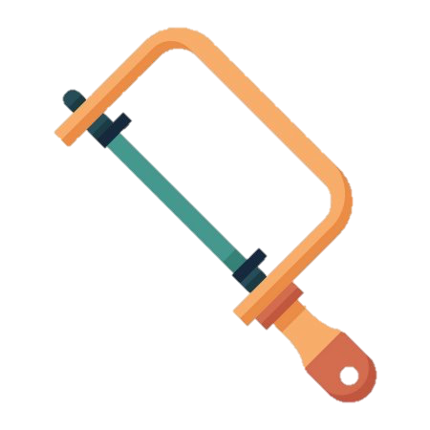



Year 8
Learning Journey
Year 9
PRODUCT DESIGN
PASSIVE AMPLIFIER
End of unit assessment
Assessed work
Practical skills
Isometric drawing
Obsolescence
CAD./CAM
Tenon saw
Coping saw
Junior hacksaw
CAD/CAM
End of unit assessment
8e
D&T Element: Isometric drawing
Theory: Obsolescence
Food miles
Seasonality
Assessed work
FOOD TECHNOLOGY
Practical skills
D&T Element: Plan of making
Seasonality
Plan of making
Extended writing piece-environment
Ice cream
Sorbet
Brownies
Cookies
Honeycomb
Ingredients
Equipment
Health and safety
Contingency
Assessed work
8d
Theory: Seasonality
End of unit assessment
Theory: Ergonomics
User profile
Ergonomics
Fabric analysis
Link to food miles
Seasonal foods
Theory: Fabric analysis
D&T Element: User profile
Practical skills
ETHOS PROJECT
DEMENTIA BLANKET
Comfort
Safety
Easy to use
Properties
Suitablity
Hand stitching
Tie dye
Stenciling
Templates
Day in the life
Interview
D&T Element:
Product analysis
Assessed work
End of unit assessment
8c
Propose dishes which suit a brief
Nutrients
Adapt to make healthier
Skills
Food miles
Product analysis
Diary of making
Practical skills
Theory: Food miles
FOOD TECHNOLOGY
Pasta
Meatballs
Puff pastry
Pizza swirls
Sausage rolls
Stuffed chicken
Function of different nutrients
Deficiencies
Food miles
Reduce
Working conditions
8b
Assessed work
End of unit assessment
Theory: Environment
Scale drawings
Practical skills
Environment
TEXTILES
CUSHION
Practical skills
D&T Element:
Design ideas
8a
6 Rs
Fairtrade
Hand stitching
Tie dye
Stenciling
Templates
Multiple design ideas
Technical information

