Slide 1

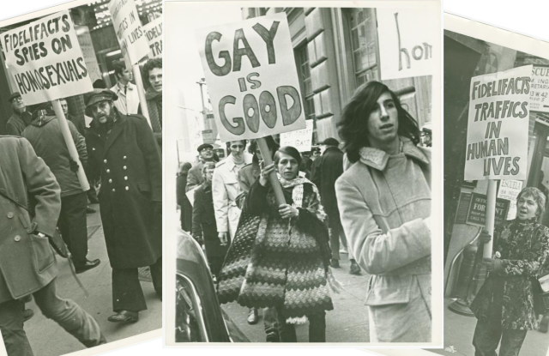



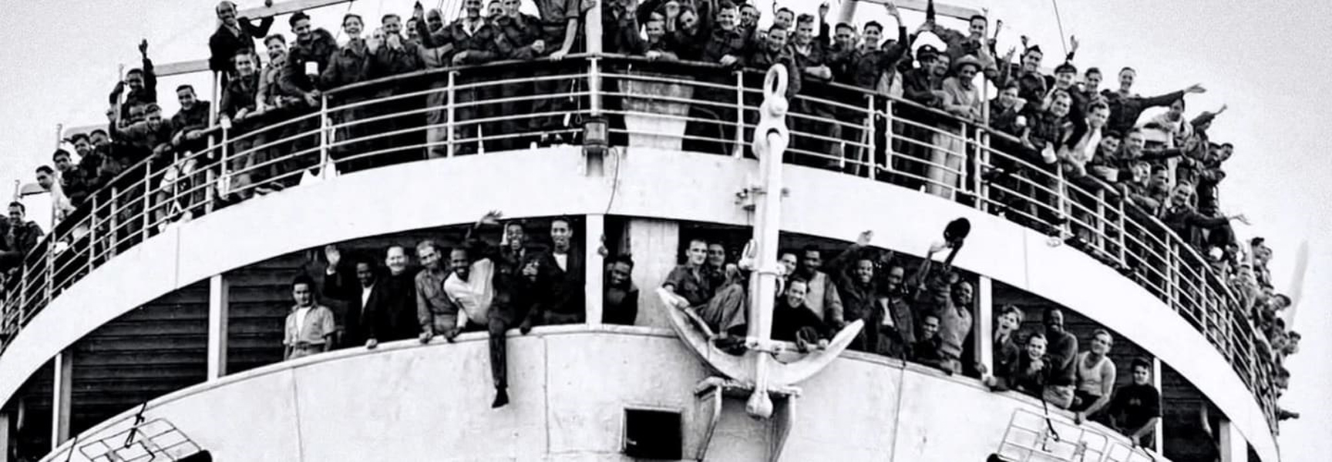

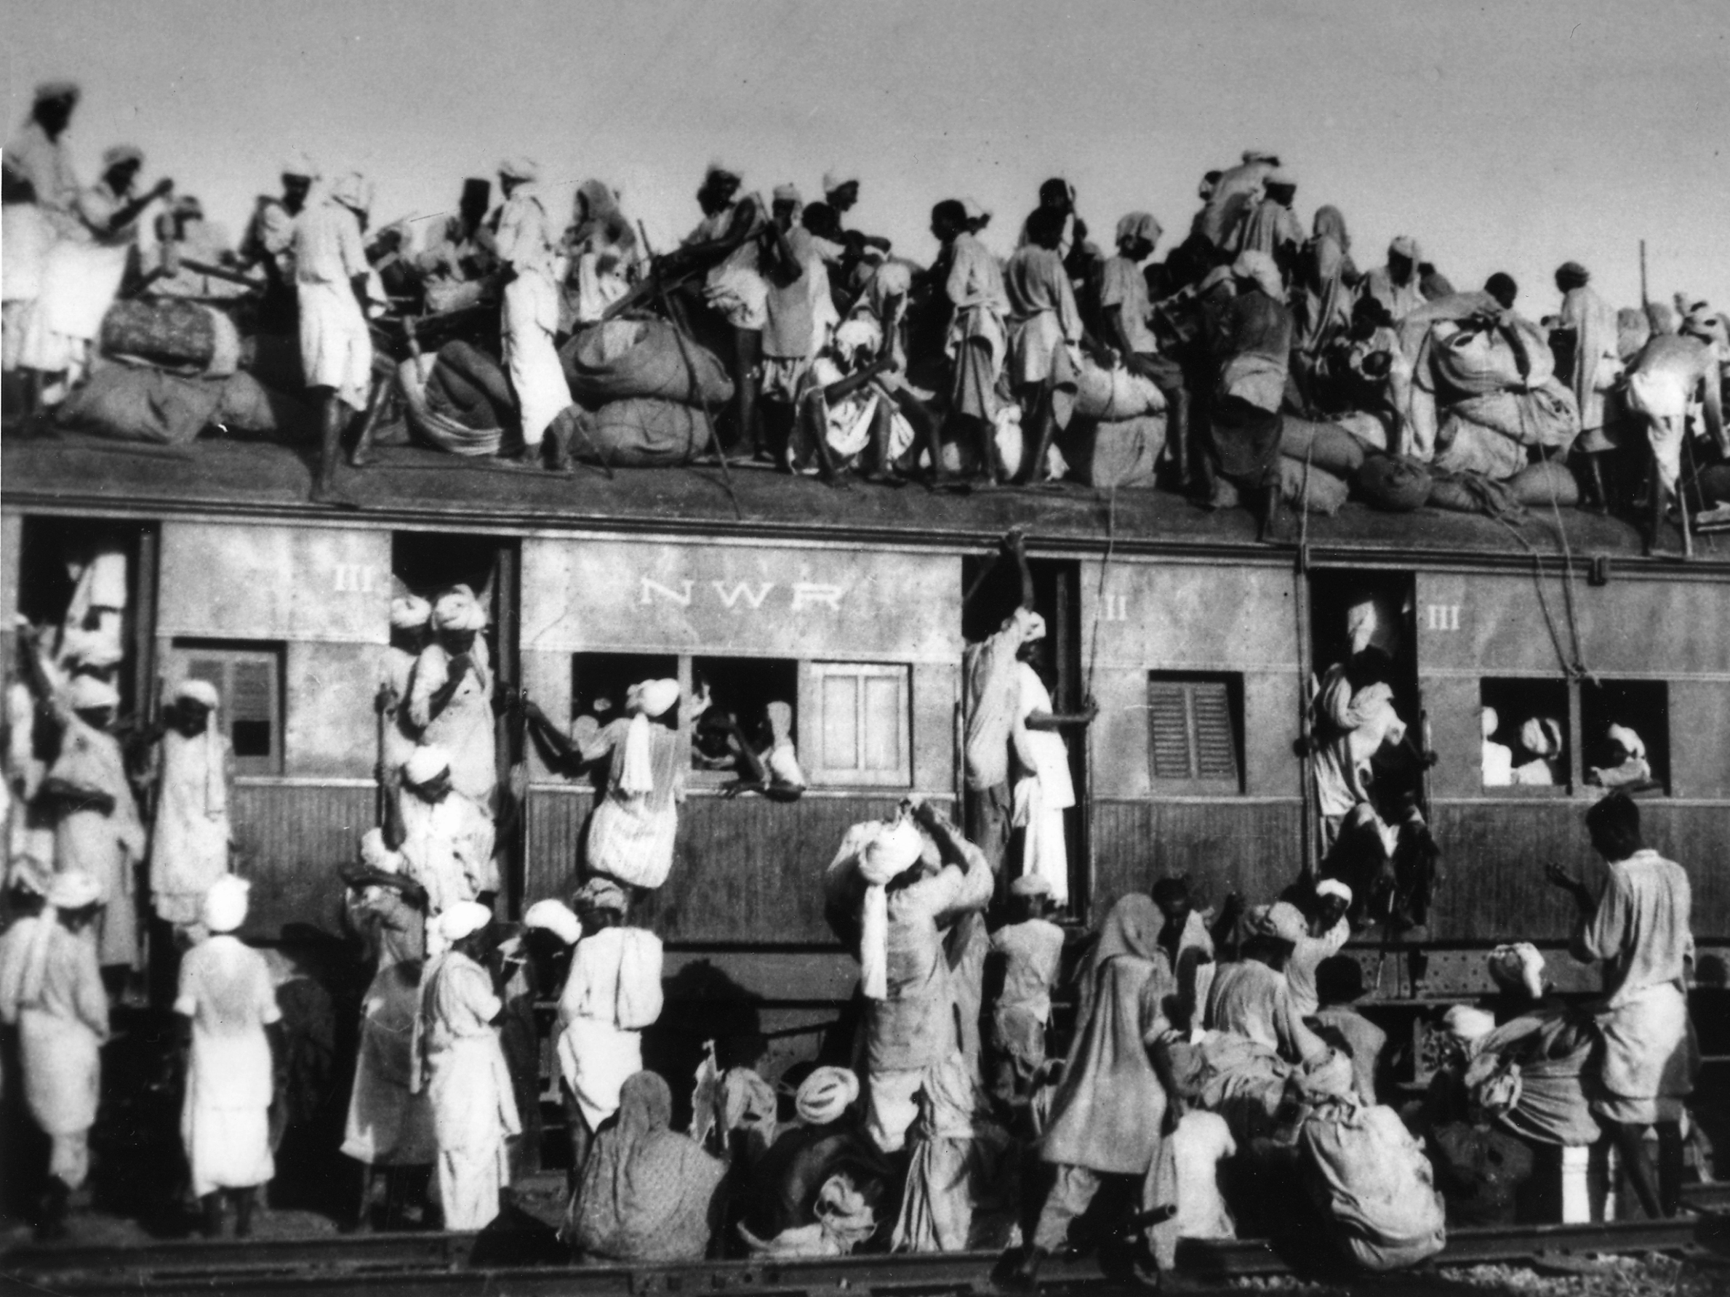
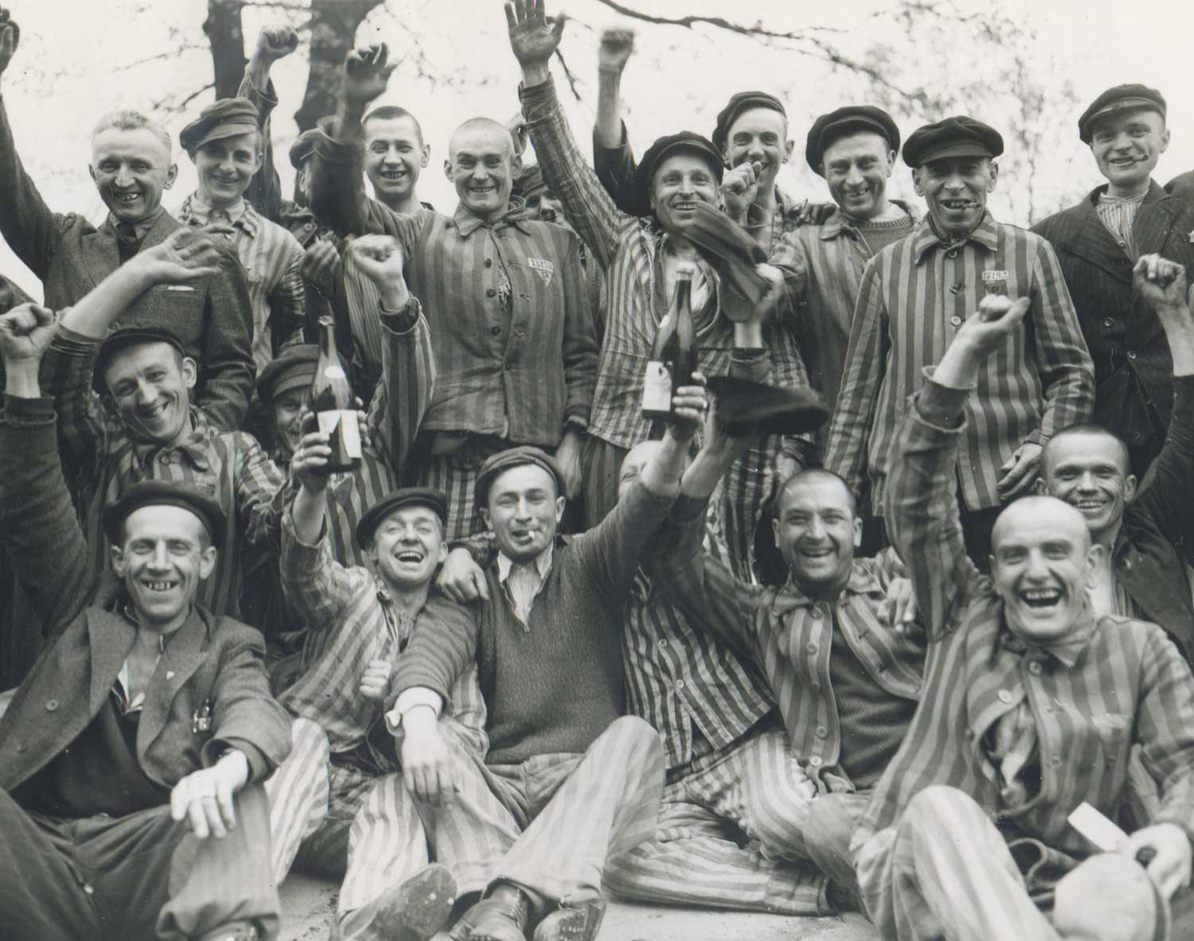
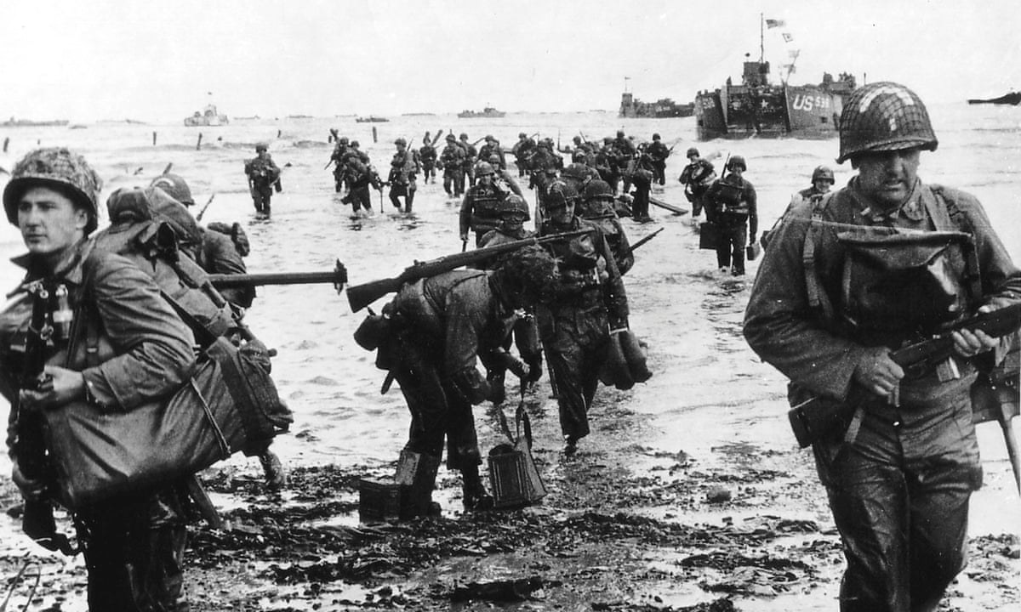
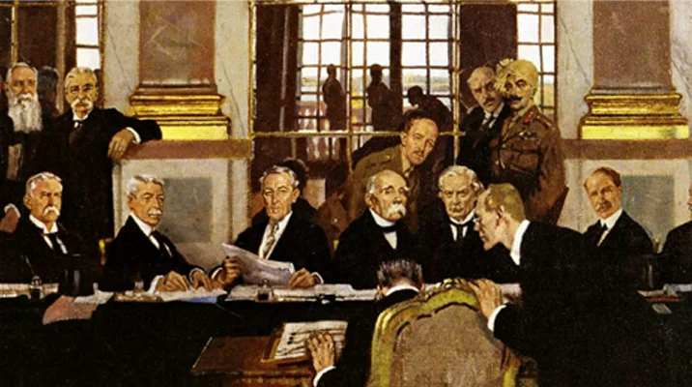
The BHS Learning Journey – Y9 History 1918-PD
GCSE History this way!
How did the fight for LGBTQ+ rights develop in the 1970s and 1980s?
Did parliament, protest or pop culture do the most to improve the rights of LGBTQ+ people in Britain in the 1950s and 1960s?
Progress Check: How has the twentieth century moved towards equality for the LGBTQ+ community?
End of Year 9 Preparation
Assessment:
End of Year Exams
How has the twentieth century moved towards equality for the LGBTQ+ community?
Was the violence in Brixton in 1981 a riot or an uprising?
How successful was the Bristol Bus Boycott?
Progress Check: What is the legacy of the Caribbean Carnival in Notting Hill?
Year 9 Summer Term 3B
Who was Claudia Jones and what did she do to increase equality for Caribbean migrants in England?
Summative Assessment: Was the violence in Brixton in 1981 a riot or an uprising?
Who were the Suffragists?
Who were the Suffragettes?
How did women achieve the right to vote in Britain?
Progress Check: Did the Suffragettes policy of 'Deeds not words' work?
What were the experiences of Caribbean migrants before World War Two?
How did the Windrush migration impact relations and equality in Britain in the 1960s?
What was life like for women before 1900 in Britain?
How has the twentieth century moved towards equality for women?
How has the twentieth century moved towards equality for migrants to the UK?
Year 9 Summer Term 3A
Progress Check: What can you learn about the impact of Partition from the work of the Migrant Memory and the Post Colonial Imagination Project?
What was the impact of Partition?
Why was 1947 such a significant year in the history of the Indian subcontinent?
What did the people of India do to gain their independence from Britain?
What did the Second World War mean for the British Empire?
How did Indians challenge British rule after the First World War?
How did the British Empire decline after World War Two?
Progress Check: How did the lives of Jews in Germany worsen 1933-38?
Why were Ghettos established in Eastern Europe?
Who were the Einsatzgruppen and what did they do?
What was the Final Solution?
How were the Death Camps liberated and liquidated?
Summative Assessment: How did the experiences of Jews in Eastern Europe worsen 1939-45?
Year 9 Spring Term 2B
What were the causes, events and consequences of Kristallnacht?
What is anti-Semitism and why has it been a problem historically?
What was life like for people living in Eastern Europe?
Year 9 Spring Term 2A
Summative Assessment: Why was D-Day considered a turning point in World War Two?
How did people in Britain celebrate VE Day?
What was the Holocaust and how did it happen?
How did the D-Day Landings contribute to Germany’s defeat?
What are the Nuremberg Laws and how did they impact the lives of Jewish people in Germany?
How did life change for civilians in Burnley during World War Two?
Was Dunkirk a glorious victory, or a devastating defeat?
How significant was the Battle of Britain?
How were prisoners of war treated on the railway of death?
Summative Assessment: How far do you agree with historian Patrick Finney’s view that World War Two happened because of the ‘international order established after the First World War’.
Year 9 Autumn Term 1B
Can Britain claim to have ‘won the Second World War’?
Progress Check: What does Source A suggest about reactions to the Treaty of Versailles?
What were the terms and conditions of the Treaty of Versailles?
What did the Big Three want from peace negotiations?
Why did World War One end with an armistice? ​
How badly was Manchester impacted by the Blitz?
Why did appeasement not work?
Year 9 Autumn Term 1A
What is appeasement?
Did World War Two happen because of the ‘international order established after the First World War’?
How did the League of Nations fail to stop the invasion of Abyssinia?
What was the League of Nations?

